Slide 1



Neural Networks Optimization and Regularization
Indian Institute of Information Technology, Allahabad
By
Dr. Shiv Ram Dubey Assistant Professor Computer Vision And Biometrics Lab (CVBL) Department Of Information Technology Indian Institute Of Information Technology, Allahabad
Email: srdubey@iiita.ac.in Web: https://profile.iiita.ac.in/srdubey/

Slide 2
Disclaimer
The content (text, image, and graphics) used in this slide are adopted from many sources for Academic purposes. Broadly, the sources have been given due credit appropriately. However, there is a chance of missing out some original primary sources. The authors of this material do not claim any copyright of such material.

Slide 3
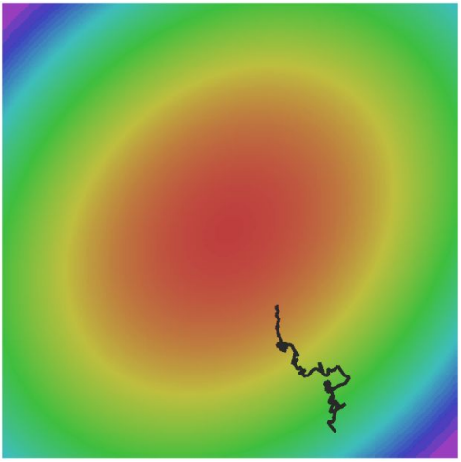
Optimization

Slide 4
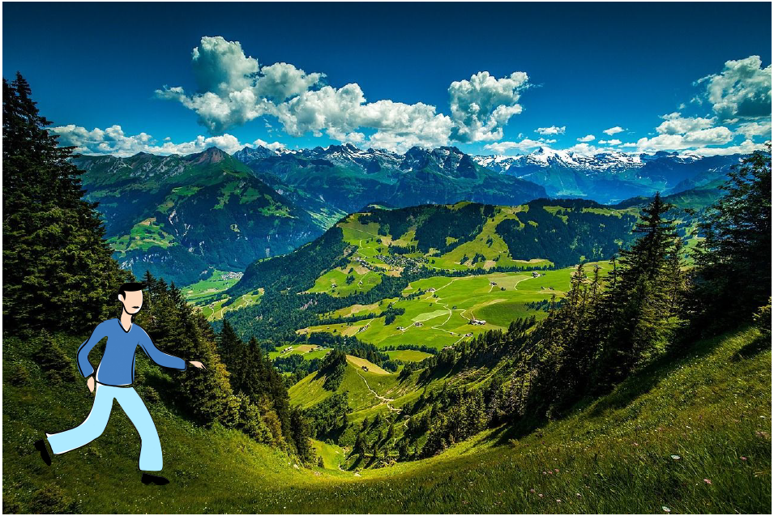
Optimization
Source: cs231n

Slide 5
Mini-batch SGD
Loop:
1. Sample a batch of data
2. Forward prop it through the graph
(network), get loss
3. Backprop to calculate the gradients
4. Update the parameters using the gradient
Source: cs231n

Slide 6
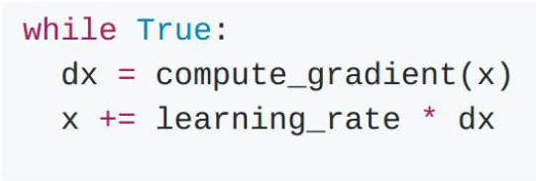
Stochastic Gradient Descent (SGD)
The procedure of repeatedly evaluating the gradient of loss function and then performing a parameter update.
Vanilla (Original) Gradient Descent:
Source: cs231n

Slide 7
SGD: Problems
What if loss changes quickly in one direction and slowly in another?
Source: cs231n

Slide 8
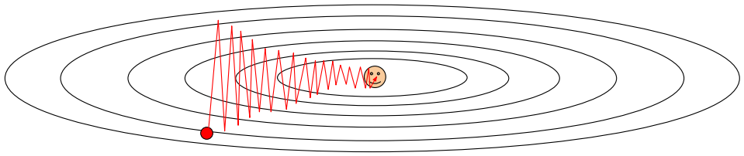
SGD: Problems
What if loss changes quickly in one direction and slowly in another?
Very slow progress along shallow dimension, jitter along steep direction
Source: cs231n

Slide 9
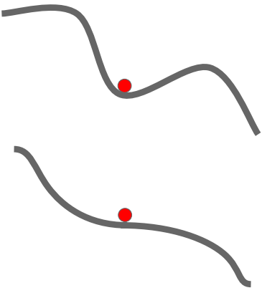
SGD: Problems
What if the loss function has a local minima or saddle point?
Source: cs231n

Slide 10
SGD: Problems
What if the loss function has a local minima or saddle point?
Zero gradient,
gradient descent
gets stuck
Source: cs231n

Slide 11
SGD: Problems
What if the loss function has a local minima or saddle point?
Zero gradient,
gradient descent
gets stuck
Saddle points much more common in high dimension
Dauphin et al, “Identifying and attacking the saddle point problem in high-dimensional non-convex optimization”, NIPS 2014
Source: cs231n

Slide 12
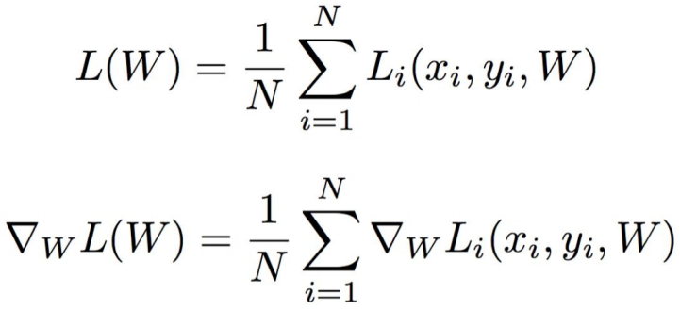
SGD: Problems
Our gradients come from minibatches so they can be noisy!
Source: cs231n

Slide 13
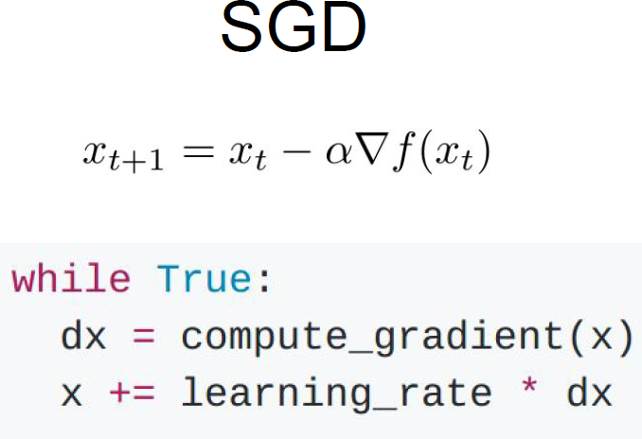
SGD + Momentum
Source: cs231n

Slide 14
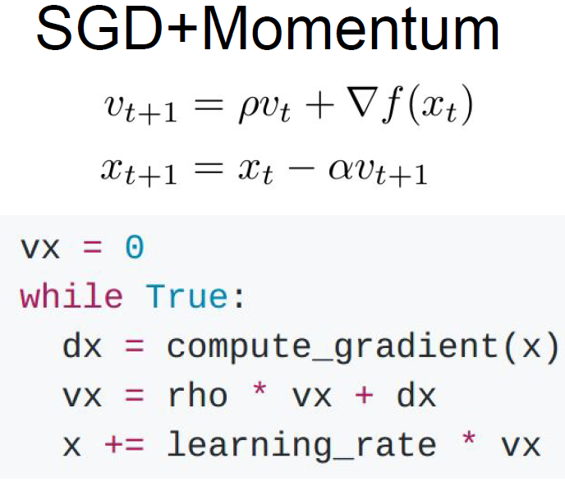
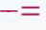
SGD + Momentum
Source: cs231n

Slide 15
SGD + Momentum
Source: cs231n

Slide 16
SGD + Momentum
Build up “velocity” in any direction that has consistent gradient
Rho gives “friction”; typically rho=0.9 or 0.99
Source: cs231n

Slide 17
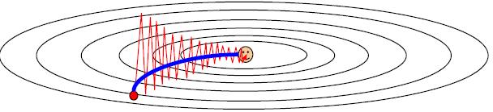
SGD + Momentum
Source: cs231n

Slide 18
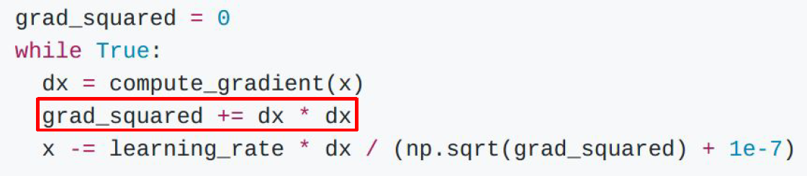
AdaGrad
Added element-wise scaling of the gradient based on the historical sum of squares in each dimension
Duchi et al, “Adaptive subgradient methods for online learning and stochastic optimization”, JMLR 2011
Source: cs231n

Slide 19
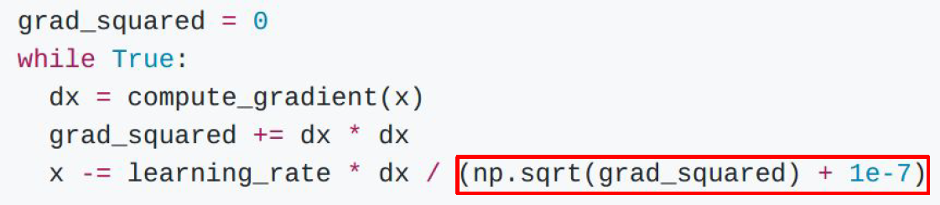
AdaGrad
What happens to the step size over long time?
Duchi et al, “Adaptive subgradient methods for online learning and stochastic optimization”, JMLR 2011
Source: cs231n

Slide 20
AdaGrad
What happens to the step size over long time?
Effective learning rate diminishing problem
Duchi et al, “Adaptive subgradient methods for online learning and stochastic optimization”, JMLR 2011
Source: cs231n

Slide 21
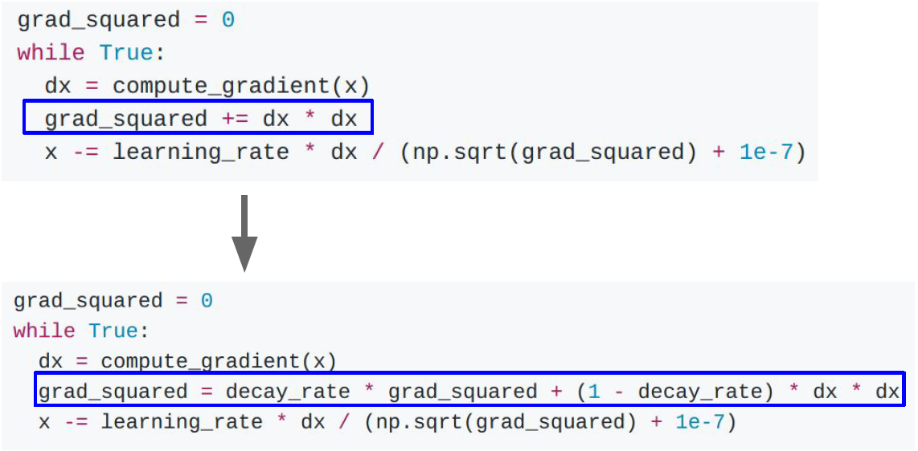
RMSProp
AdaGrad
RMSProp
Tieleman and Hinton, 2012
Source: cs231n

Slide 22
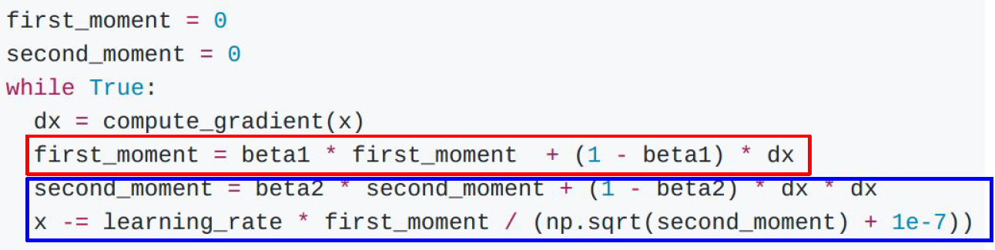
Adam
Kingma and Ba, “Adam: A method for stochastic optimization”, ICLR 2015
Source: cs231n

Slide 23
Adam
Kingma and Ba, “Adam: A method for stochastic optimization”, ICLR 2015
Sort of like RMSProp with Momentum
Source: cs231n

Slide 24
Adam
Kingma and Ba, “Adam: A method for stochastic optimization”, ICLR 2015
Sort of like RMSProp with Momentum
Problem:
Initially, second_moment=0 and beta2=0.999
After 1st iteration, second_moment -> close to zero
So, very large step for update of x
Source: cs231n

Slide 25
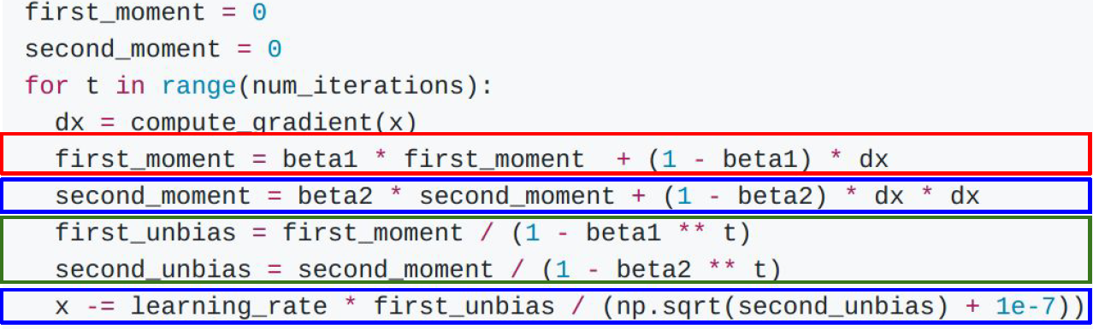
Adam (with Bias correction)
Kingma and Ba, “Adam: A method for stochastic optimization”, ICLR 2015
AdaGrad/
RMSProp
Bias Correction
Momentum
Bias correction for the fact that first and second moment estimates start at zero
Source: cs231n

Slide 26
Adam (with Bias correction)
Kingma and Ba, “Adam: A method for stochastic optimization”, ICLR 2015
AdaGrad/
RMSProp
Bias Correction
Momentum
Bias correction for the fact that first and second moment estimates start at zero
Adam with beta1 = 0.9,
beta2 = 0.999, and learning_rate = 1e-3 or 5e-4
is a great starting point for many models!
Source: cs231n

Slide 27
Major Problem with Adam
Does not the optimization trajectory information such as short term gradient behavior
Overshoots the optima
Oscillates near the optima

Slide 28
Recent SGD Based Optimizers
diffGrad (IEEE TNNLS 2020) – by us
AdaBelief (NeurIPS 2020)
Rectified Adam (RADAM) (ICLR 2020)
Moment Centralization SGD (CVMI 2022) – by us
AdaInject (IEEE TAI 2022) – by us
AdaNorm (WACV 2023) – by us
and many more.... still a challenging problem.
https://pythonawesome.com/a-collection-of-optimizers-for-pytorch/

Slide 29
diffGrad Optimizer
Solves the previously mentioned problems by incorporating the local gradient change as friction in effective learning rate.
High local gradient change → low friction → high learning rate
Small local gradient change → high friction → slow learning rate
S.R. Dubey et al. (2020), diffGrad: An Optimization Method for Convolutional Neural Networks, IEEE Transactions on Neural Network and Learning Systems.

Slide 30
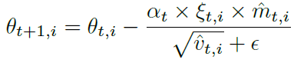
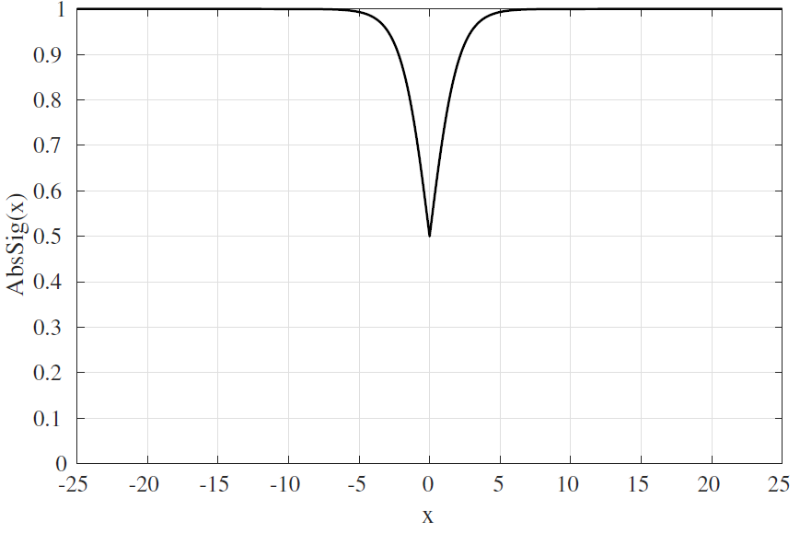
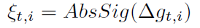
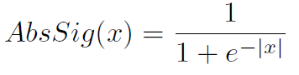
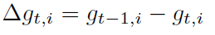
diffGrad Optimizer
S.R. Dubey et al. (2020), diffGrad: An Optimization Method for Convolutional Neural Networks, IEEE Transactions on Neural Network and Learning Systems.

Slide 31
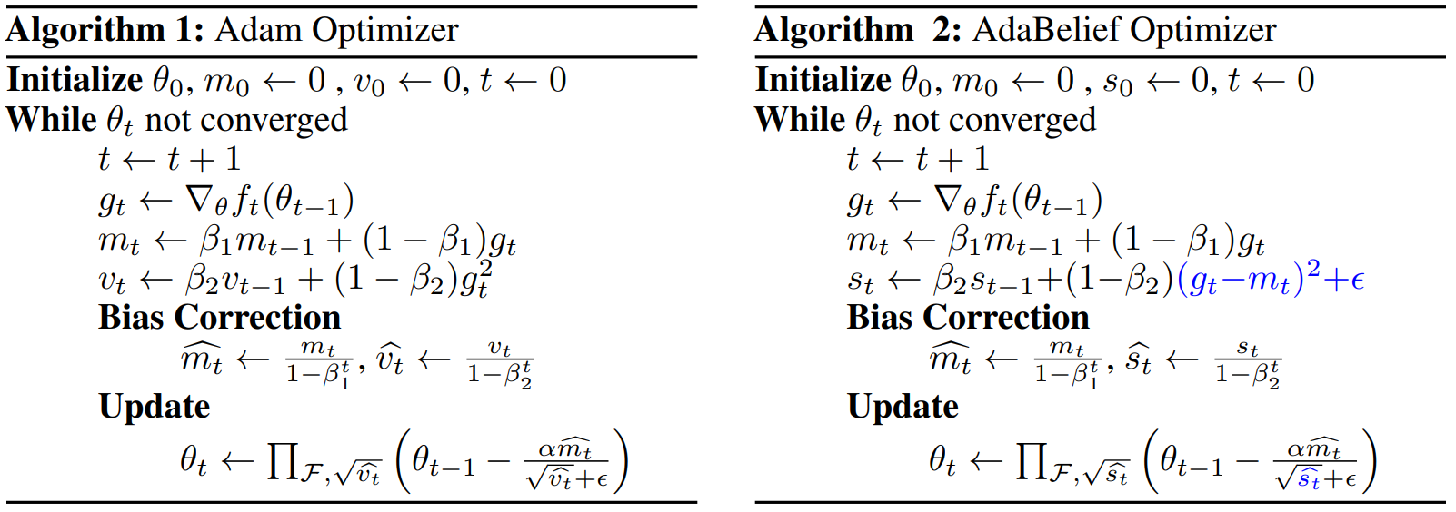
Adabelief Optimizer
Adabelief optimizer: Adapting stepsizes by the belief in observed gradients. Advances in neural information processing systems, 2020.

Slide 32
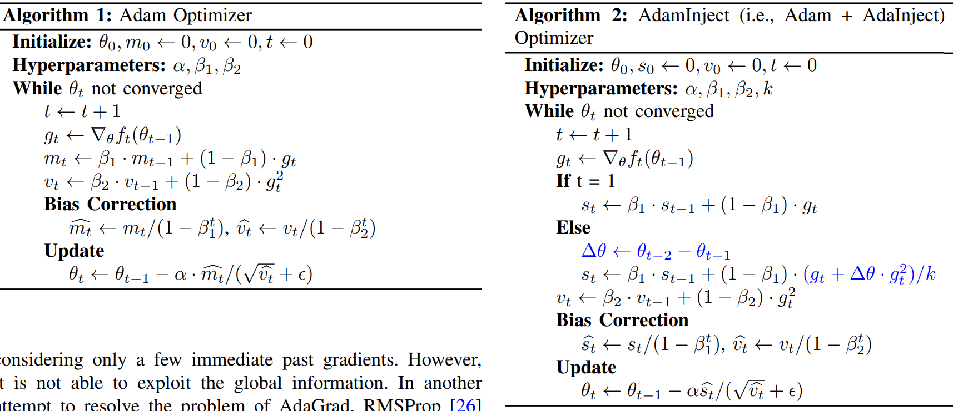
AdaINJECT Optimizer
AdaInject: Injection Based Adaptive Gradient Descent Optimizers for Convolutional Neural Networks. IEEE TAI 2022.

Slide 33
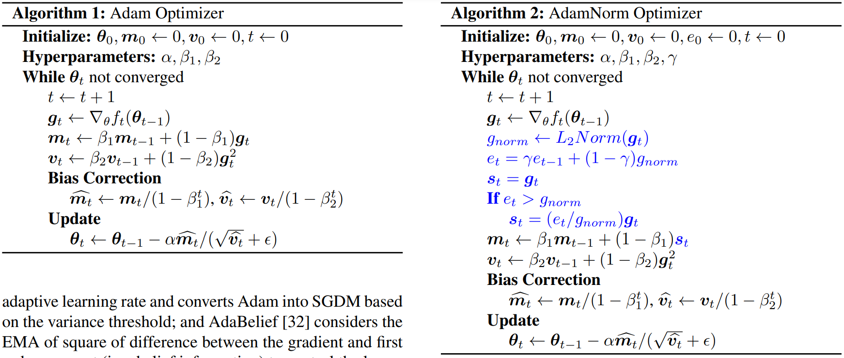
AdaNORM Optimizer
AdaNorm: Adaptive Gradient Norm Correction based Optimizer for CNNs. WACV 2023.

Slide 34
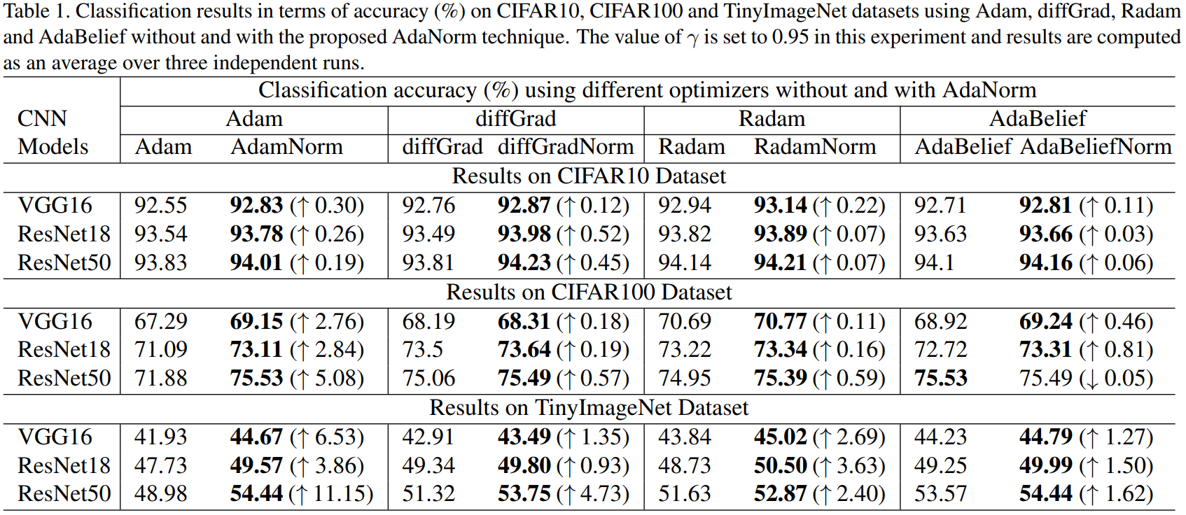
AdaNORM Optimizer
AdaNorm: Adaptive Gradient Norm Correction based Optimizer for CNNs. WACV 2023.

Slide 35
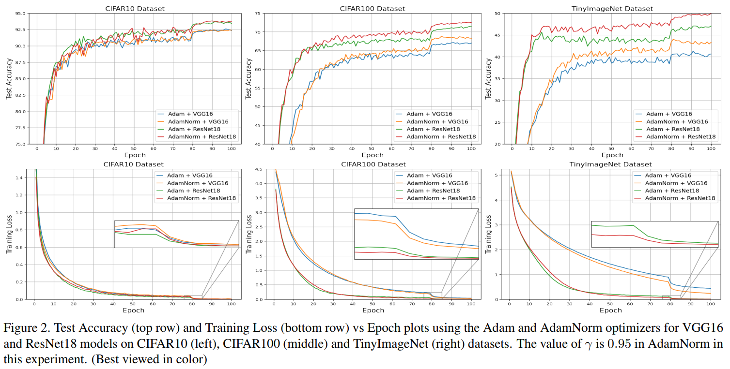
AdaNORM Optimizer
AdaNorm: Adaptive Gradient Norm Correction based Optimizer for CNNs. WACV 2023.

Slide 36
Optimizer
In Practice:
Adam is a good default choice in most cases
Try out diffGrad, RADAM, AdaBelief, AdaInject, and AdaNorm
More Optimizer: http://ruder.io/optimizing-gradient-descent/

Slide 37
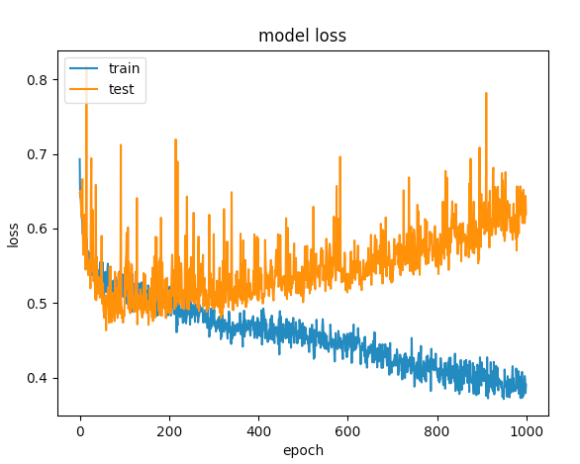
Regularization
Image Source: https://stackoverflow.com/questions/44909134/how-to-avoid-overfitting-
on-a-simple-feed-forward-network/44985765

Slide 38
Regularization
Techniques for controlling the capacity of a neural network to prevent overfitting

Slide 39
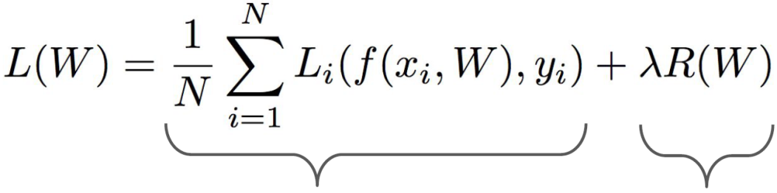
Regularization
Data loss: Model predictions
should match training data
Source: cs231n

Slide 40
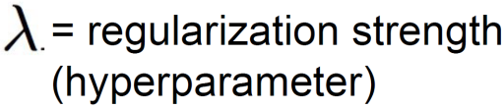
Regularization
Data loss: Model predictions
should match training data
Regularization: Prevent the model
from doing too well on training data
Source: cs231n

Slide 41
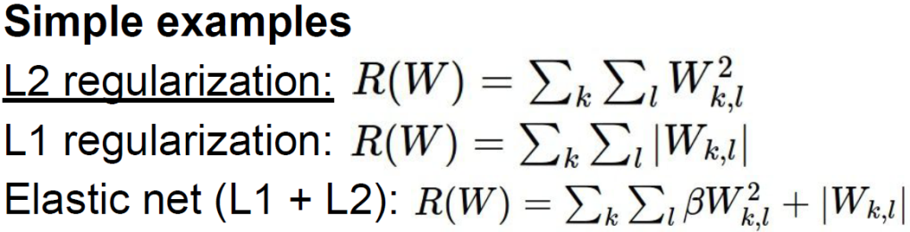
Regularization
Data loss: Model predictions
should match training data
Regularization: Prevent the model
from doing too well on training data
Source: cs231n

Slide 42
Regularization
Data loss: Model predictions
should match training data
Regularization: Prevent the model
from doing too well on training data
Why regularize?
- Express preferences over weights
- Make the model simple so it works on test data
- Improve optimization by adding curvature
Source: cs231n

Slide 43
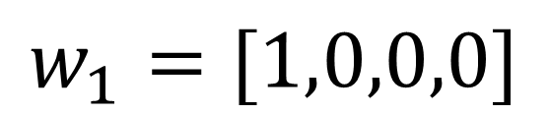
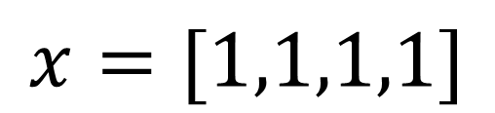
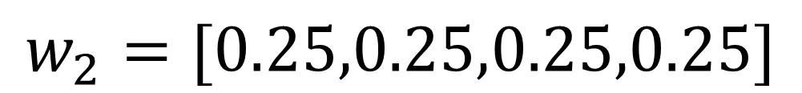
Regularization
$$x=[1,1,1,1]$$
$$w_{1}=[1,0,0,0]$$
$$w_{2}=[0.25,0.25,0.25,0.25]$$
Source: cs231n

Slide 44
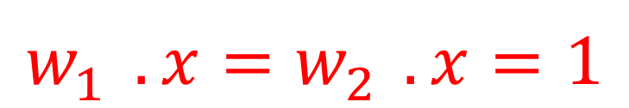
Regularization
$$x=[1,1,1,1]$$
$$w_{1}=[1,0,0,0]$$
$$w_{2}=[0.25,0.25,0.25,0.25]$$
$$w_{1}^{}.x=w_{2}^{}.x=1$$
Source: cs231n

Slide 45
Regularization
$$x=[1,1,1,1]$$
$$w_{1}=[1,0,0,0]$$
$$w_{2}=[0.25,0.25,0.25,0.25]$$
$$w_{1}^{}.x=w_{2}^{}.x=1$$
Which W to consider?
Source: cs231n

Slide 46
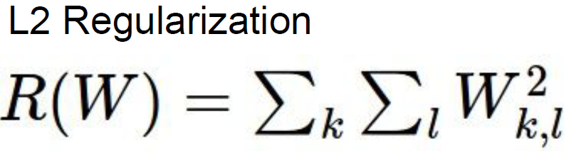
Regularization
$$x=[1,1,1,1]$$
$$w_{1}=[1,0,0,0]$$
$$w_{2}=[0.25,0.25,0.25,0.25]$$
$$w_{1}^{}.x=w_{2}^{}.x=1$$
Source: cs231n

Slide 47
Regularization
$$x=[1,1,1,1]$$
$$w_{1}=[1,0,0,0]$$
$$w_{2}=[0.25,0.25,0.25,0.25]$$
L2 regularization likes to
“spread out” the weights
$$w_{1}^{}.x=w_{2}^{}.x=1$$
Source: cs231n

Slide 48
Other types of regularization
Dropout
Dropconnect
Batch Normalization
Data Augmentation

Slide 49
Dropout

Slide 50
Dropout
In each forward pass, randomly set some neurons to zero
Probability of dropping is a hyperparameter; 0.5 is common
Source: cs231n
Dropout: A simple way to prevent neural networks from overfitting [Srivastava JMLR 2014]

Slide 51
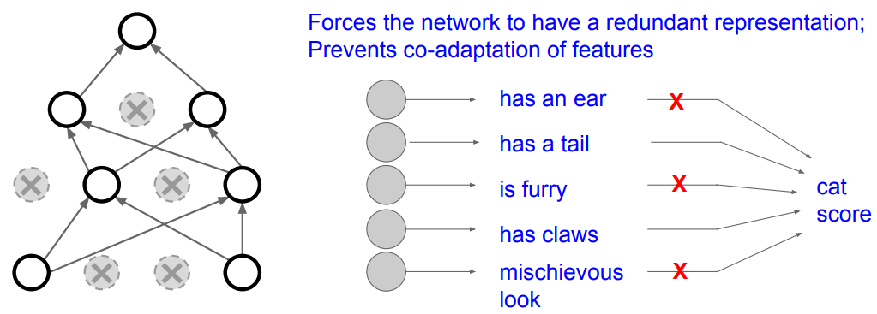
Dropout
How can this possibly be a good idea?
Source: cs231n

Slide 52
Dropout
How can this possibly be a good idea?
Intuitions
Prevent “co-adaptation” of units, increase robustness to noise
Train implicit ensemble
Source: cs231n

Slide 53
Dropout
How can this possibly be a good idea?
Source: cs231n

Slide 54
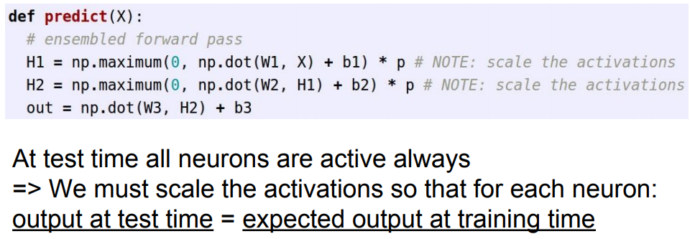
Dropout: Test Time
More common: “Inverted dropout”
Source: cs231n

Slide 55
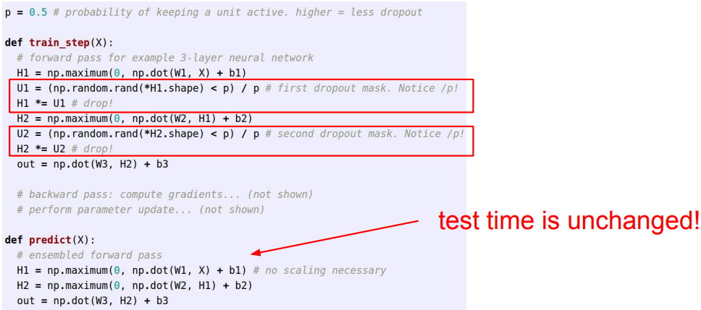
Dropout: More common: “Inverted dropout”
We drop and scale at train time and don't do anything at test time.
Source: cs231n

Slide 56
Current status of dropout
Against
Slows down convergence
Made redundant by batch normalization or possibly even clashes with it
Unnecessary for larger datasets or with sufficient data augmentation
In favor
Can still help in certain situations: e.g., used in Wide Residual Networks
Helpful in RNNs

Slide 57
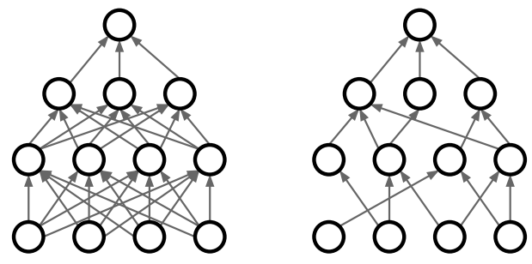
DropConnect
Dropping some connections
Wan et al, “Regularization of Neural Networks using DropConnect”, ICML 2013
Source: cs231n

Slide 58
Batch Normalization

Slide 59
Batch Normalization
“We want zero-mean unit-variance activations? lets make them so.”
Batch Normalization: Accelerating Deep Network Training by
Reducing Internal Covariate Shift [Ioffe and Szegedy 2015]
Source: cs231n

Slide 60
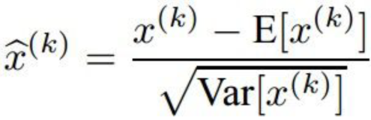
Batch Normalization
“We want zero-mean unit-variance activations? lets make them so.”
Consider a batch of activations at some layer.
To make each dimension zero-mean unit-variance, apply:
Batch Normalization: Accelerating Deep Network Training by
Reducing Internal Covariate Shift [Ioffe and Szegedy 2015]
Source: cs231n

Slide 61
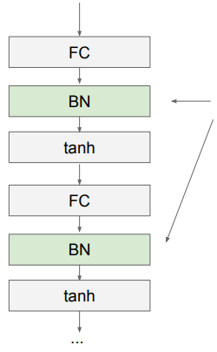
Batch Normalization
Usually inserted after Fully Connected or Convolutional layers, and before nonlinearity.
Batch Normalization: Accelerating Deep Network Training by
Reducing Internal Covariate Shift [Ioffe and Szegedy 2015]
Source: cs231n

Slide 62
Batch Normalization
Usually inserted after Fully Connected or Convolutional layers, and before nonlinearity.
Problem:
do we necessarily want a
zero-mean unit-variance input?
Batch Normalization: Accelerating Deep Network Training by
Reducing Internal Covariate Shift [Ioffe and Szegedy 2015]
Source: cs231n

Slide 63
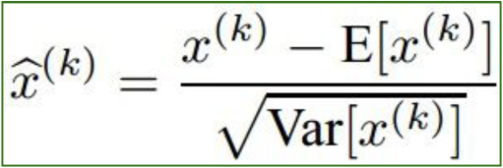
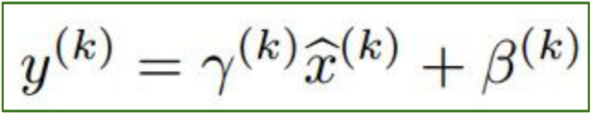
Batch Normalization
Normalize:
And then allow the network to squash
the range if it wants to:
Batch Normalization: Accelerating Deep Network Training by
Reducing Internal Covariate Shift [Ioffe and Szegedy 2015]
Source: cs231n

Slide 64
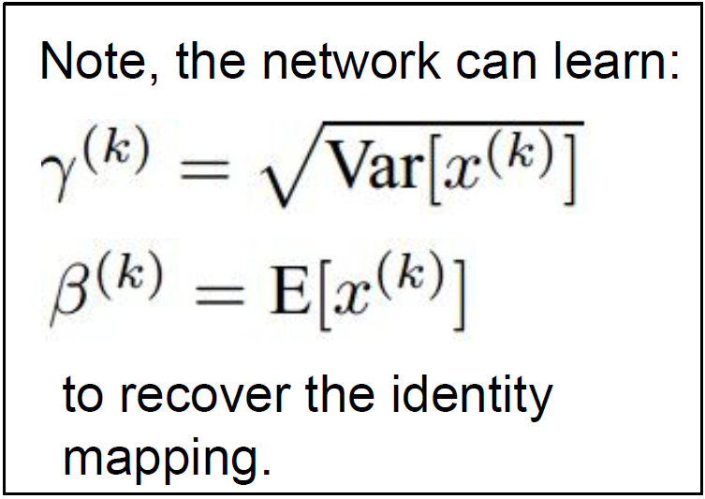
Batch Normalization
Normalize:
And then allow the network to squash
the range if it wants to:
Batch Normalization: Accelerating Deep Network Training by
Reducing Internal Covariate Shift [Ioffe and Szegedy 2015]
Source: cs231n

Slide 65
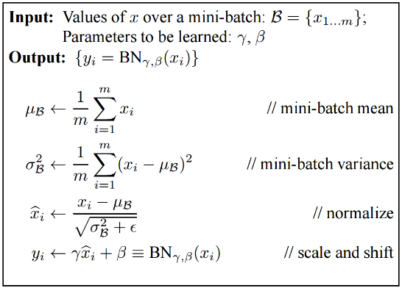
Batch Normalization
Batch Normalization: Accelerating Deep Network Training by
Reducing Internal Covariate Shift [Ioffe and Szegedy 2015]
Source: cs231n

Slide 66
Batch Normalization
Note: at test time BatchNorm layer functions differently:
The mean/std are not computed based on the batch.
Instead, a single fixed empirical mean of activations during training is used.
(e.g. can be estimated during training with running averages)
Batch Normalization: Accelerating Deep Network Training by
Reducing Internal Covariate Shift [Ioffe and Szegedy 2015]
Source: cs231n

Slide 67
Batch Normalization
At test time (usually):
training set
training set
Batch Normalization: Accelerating Deep Network Training by
Reducing Internal Covariate Shift [Ioffe and Szegedy 2015]
Source: cs231n

Slide 68
Batch Normalization
Benefits
- Improves gradient flow through the network
- Allows higher learning rates and Accelerates convergence of training
- Reduces the strong dependence on initialization
- Acts as a form of regularization
Pitfalls
Behavior depends on composition of mini-batches, can lead to hard-to-catch bugs if there is a mismatch between training and test regime (example)
Doesn’t work well for small mini-batch sizes
Cannot be used in recurrent models
Batch Normalization: Accelerating Deep Network Training by
Reducing Internal Covariate Shift [Ioffe and Szegedy 2015]
Source: cs231n

Slide 69
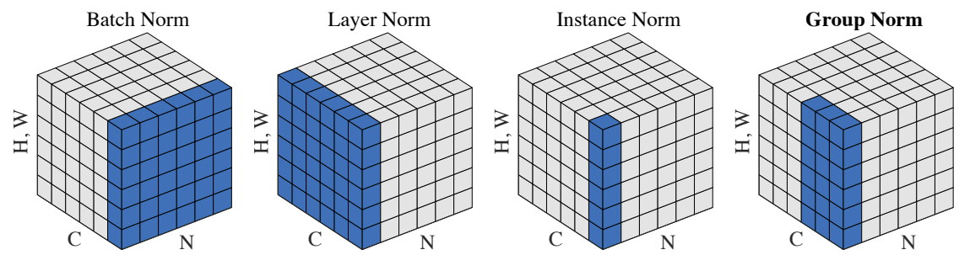
Other types of normalization
Layer normalization (Ba et al., 2016)
Instance normalization (Ulyanov et al., 2017)
Group normalization (Wu and He, 2018)
Weight normalization (Salimans et al., 2016)
Y. Wu and K. He, Group Normalization, ECCV 2018

Slide 70
Batch Normalization: Recent Trends
Layer Normalization:
Ba, Kiros, and Hinton, “Layer Normalization”, arXiv 2016
Instance Normalization:
Ulyanov et al, Improved Texture Networks: Maximizing Quality and Diversity in Feed-forward Stylization and Texture Synthesis, CVPR 2017
Group Normalization:
Wu and He, “Group Normalization”, arXiv 2018
(Appeared 3/22/2018)
Decorrelated Normalization:
Huang et al, “Decorrelated Batch Normalization”, arXiv 2018 (Appeared 4/23/2018)

Slide 71
Data Augmentation

Slide 72
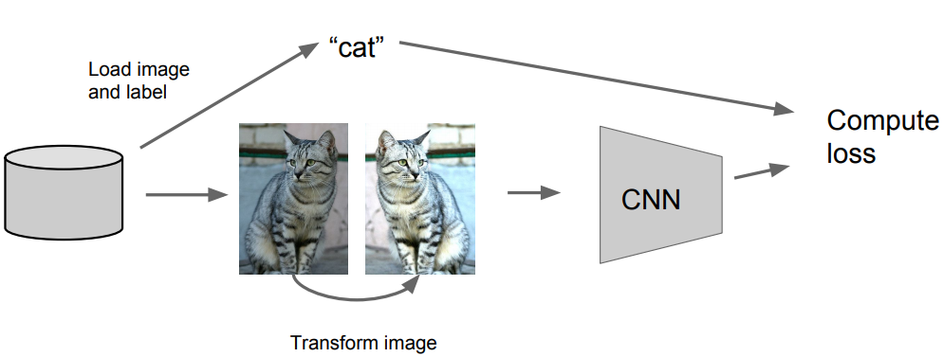
Data Augmentation (Jittering)
Source: cs231n

Slide 73
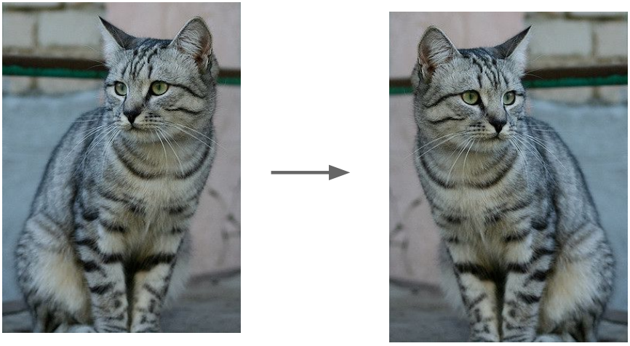
Data Augmentation (Jittering)
Horizontal Flips
Source: cs231n

Slide 74
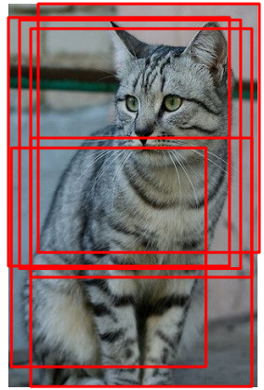
Data Augmentation (Jittering)
Random crops and scales
Source: cs231n

Slide 75
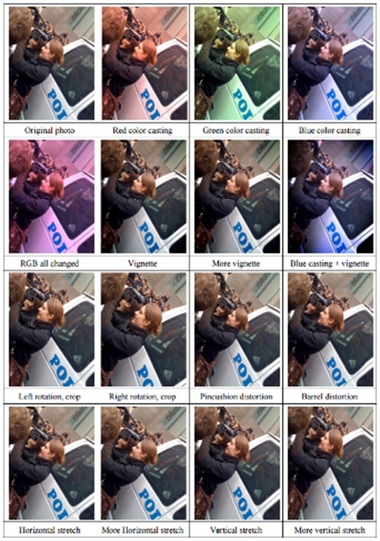
Data Augmentation (Jittering)
Create virtual training samples
Get creative for your problem!
Horizontal flip
Random crop
Color casting
Randomize contrast
Randomize brightness
Geometric distortion
Rotation
Photometric changes
Deep Image [Wu et al. 2015]

Slide 76
Transfer Learning

Slide 77
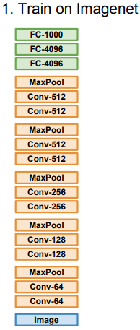
Transfer Learning with CNNs
Donahue et al, “DeCAF: A Deep Convolutional Activation Feature for Generic Visual Recognition”, ICML 2014
Razavian et al, “CNN Features Off-the-Shelf: An Astounding Baseline for Recognition”, CVPR Workshops 2014
Source: cs231n

Slide 78

Transfer Learning with CNNs
Donahue et al, “DeCAF: A Deep Convolutional Activation Feature for Generic Visual Recognition”, ICML 2014
Razavian et al, “CNN Features Off-the-Shelf: An Astounding Baseline for Recognition”, CVPR Workshops 2014
Source: cs231n

Slide 79

Transfer Learning with CNNs
Donahue et al, “DeCAF: A Deep Convolutional Activation Feature for Generic Visual Recognition”, ICML 2014
Razavian et al, “CNN Features Off-the-Shelf: An Astounding Baseline for Recognition”, CVPR Workshops 2014
Source: cs231n

Slide 80

Transfer Learning with CNNs
Source: cs231n

Slide 81

Transfer Learning with CNNs
Source: cs231n

Slide 82
Transfer Learning with CNNs
Source: cs231n

Slide 83
Transfer Learning with CNNs
Source: cs231n

Slide 84
Transfer Learning with CNNs
Source: cs231n

Slide 85
Transfer Learning with CNNs
Source: cs231n

Slide 86
Transfer Learning with CNNs
Takeaway for your projects and beyond:
Have some dataset of interest but it has < ~1M images?
Find a very large dataset that has similar data, train a big ConvNet there
Transfer learn to your dataset
Deep learning frameworks provide a “Model Zoo” of pretrained models so you don’t need to train your own
Caffe: https://github.com/BVLC/caffe/wiki/Model-Zoo
TensorFlow: https://github.com/tensorflow/models
PyTorch: https://github.com/pytorch/vision
Matconvnet: http://www.vlfeat.org/matconvnet/pretrained/
Source: cs231n

Slide 87

Monitor and visualize the loss curve
Source: cs231n

Slide 88
Monitor and visualize the loss curve
Source: cs231n

Slide 89

Monitor and visualize the loss curve
big gap = overfitting
=> increase regularization strength?
no gap
=> increase model capacity?
Source: cs231n

Slide 90






Monitor and visualize the loss curve
Not learning: gradients not applied to weights
Overfit: model too large/dataset too small
More extreme case of overfitting
slow start
Not converged yet: need longer training
Slow start: initialization weights too small
Applied the negative of gradients
Source: cs231n

Slide 91


Monitor and visualize the loss curve
Problem: val set too small, statistics not meaningful
Get nans in the loss after a number of iterations: caused by high learning rate and numerical instability in models
Source: cs231n

Slide 92
Attempt at a conclusion
Training neural networks is still a black art
Process requires close “babysitting”
For many techniques, the reasons why, when, and whether they work are in active dispute – read everything but don’t trust anything
It all comes down to (principled) trial and error
Further reading: A. Karpathy, A recipe for training neural networks

Slide 93
Acknowledgement
Thanks to the following courses and corresponding researchers for making their teaching/research material online
Deep Learning, Stanford University
Introduction to Deep Learning, University of Illinois at Urbana-Champaign
Introduction to Deep Learning, Carnegie Mellon University
Convolutional Neural Networks for Visual Recognition, Stanford University
Natural Language Processing with Deep Learning, Stanford University
And Many More ......

Slide 94
Thank You

